Slide 1




Breakfast meeting Ministry of Health Nairobi, December 5th 2023

Slide 2
Starting point for our disucssion today: KHIA
COMMON
SERVICES
CR - Client Registry
FR - Facility Registry
HWR - Health Worker Registry
TS - Terminology Services
PC - Product Catalogue
BUSINESS
SERVICES
FIS - Finance & Insurance Service
HMIS - Health Mgt. Info. System
LMIS - Logistics Mgt. Info. Service
SHR - Shared Health Record
ANALYTICS & INTELLIGENCE SERVICES
Secondary reuse of data
Based on OpenHIE*
One of the most widely used frameworks for implementing health data exchange in Africa
Standards-based, modular and with increasing number of implementations
Relevance today
Digital technologies have matured in the past decade, creating opportunities for effective and efficient implementations using digital public goods
Extend framework to support secondary re-use for analytics
INTEROPERABILITY LAYER (IOL)
AC - Admin Console
ATNA - Audit Trail & Node Authentication
ILS - Interlinking and Routing Services, also known as Channels in the reference implementation
MEDIATORS - Pass-through, Adapter or Orchestration mediators
POINT OF SERVICE (POS) SYSTEMS
Different types of PoS systems are allowed, including EMR/EHRs (Electronic Health / Medical Record systems), mobile apps for patient or community workers and information systems for hospitals, pharmacies and laboratories.
Key defining characteristics are the workflows that are supported by the system (see examples).
* Similar architectures have been adopted in Nigeria, Kenya, Tanzania. For more details see OpenHIE documentation, review HIE in Africa.

Slide 3

“Data is a precious thing and will last longer than
the systems themselves.”
– Sir Tim Berners-Lee

Slide 4
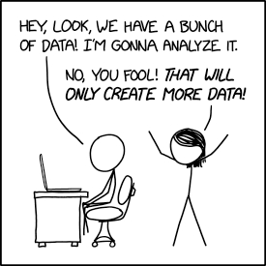
#buthow?
Source: https://xkcd.com/2582

Slide 5

How did the internet become so ubiquitous?
Source: Beck (2019), On the Hourglass Model
Application layer: apps, email, video conferencing
Minimal protocols
Internet protocol
Physical layer:
Mobile, fibre, satellite network, cable, DSL

Slide 6


Conceptualizing data sharing with the hourglass model
Primary and secondary data use
Collaborative approach
Develop ecosystems that address patient needs
Develop new care concepts with service providers
Introduce enablers for people to exercise their personal data rights
Personal, health-related data of patients are the fundamental building blocks of a digitally-enabled healthcare ecosystem
Shared Health Record of patients is exchanged with minimal standards
Digital public goods and tech neutrality
Implement health data commons using digital public goods
Prevent vendor lock-in through technology-neutral reference implementations
Brick
Click
Point of Care Service Providers

Slide 7
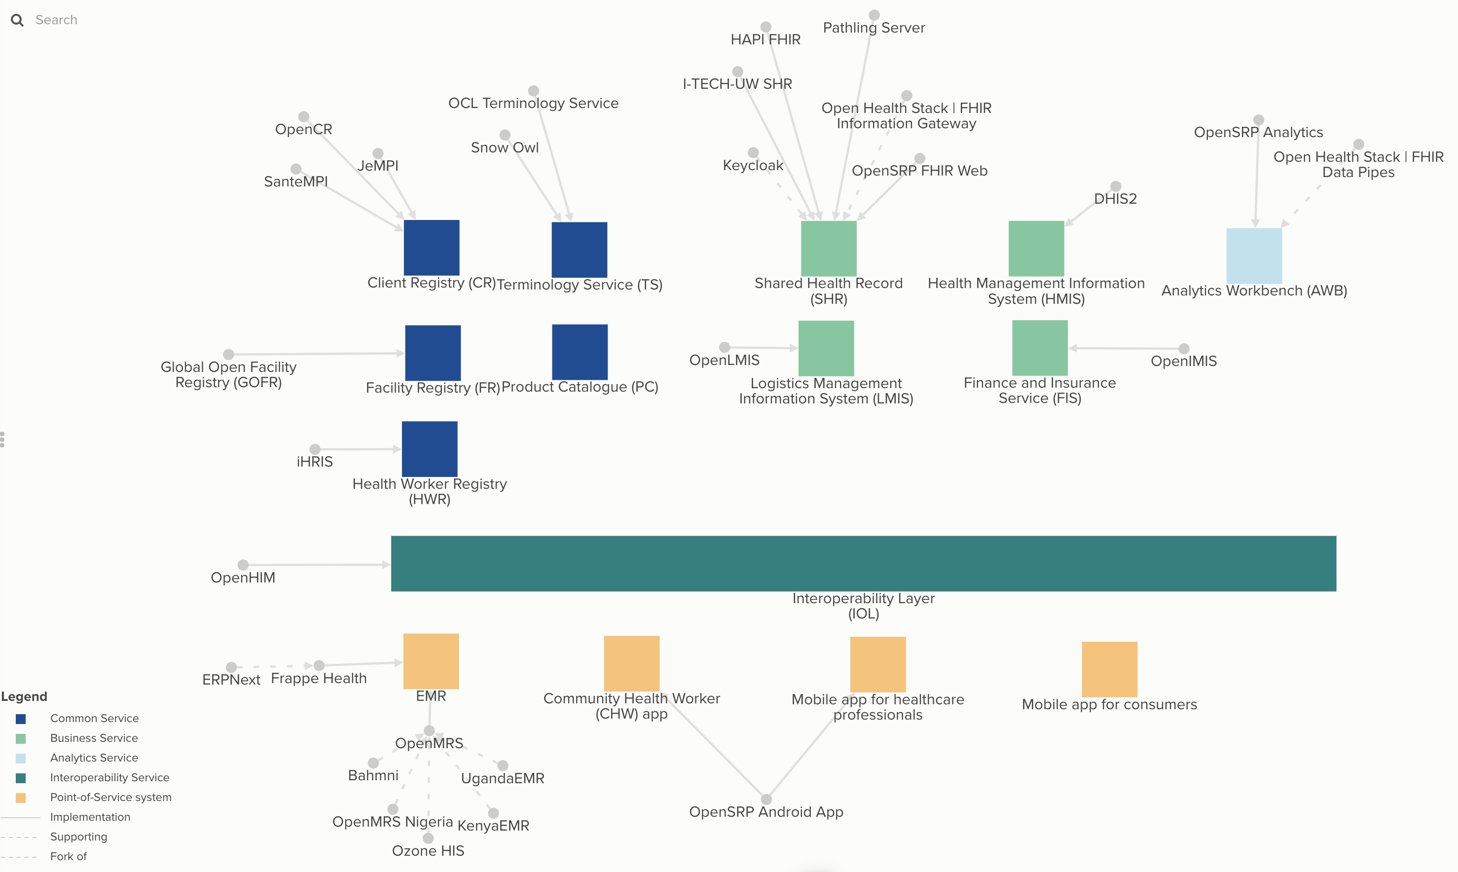
Our approach
Source: https://kumu.io/pharmaccess/health-data-commons
International Patient Summary (IPS) as “minimal SHR”
FHIR as the minimal common standard
“Instant HIE” through integration of digital public goods
Partner with digital solutions providers with Kenyan presence

Slide 8
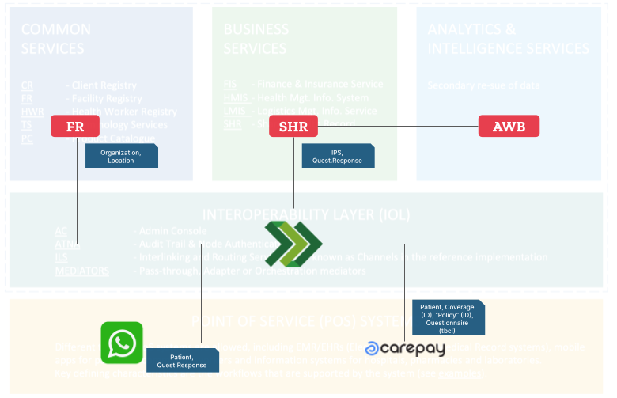
Building demonstrators with specific use-cases

Slide 9

Demonstrate fair data sharing based on data solidarity
Three pillars of solidarity-based data sharing
1. Facilitating data use that creates significant public value
2.
Preventing and mitigating harm
3. Revenue sharing / “taxing” data use by third parties that generate little or no public value
Source: Barbara Prainsack et al., Data Solidarity (2022)

Slide 10
Points for discussion
Digital infrastructure
Are our perspectives and approaches aligned?
What is current status of national roll-out?
What is our perspective specifically on standardizing health claims exchange?
…
Governance
How do we gain citizen’s trust for data sharing?
How do we envision the roles and responsibilities at national / county / individual level?
…

Slide 11
Appendix

Slide 12
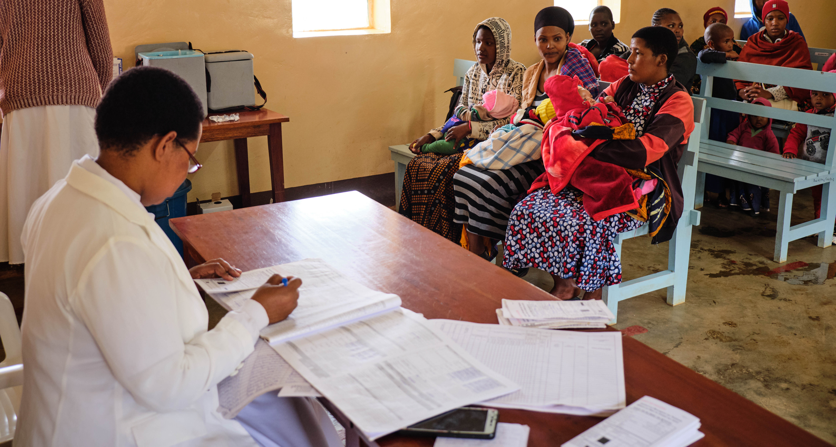

Slide 13






MomCare is a care bundle powered by mobile communication, quality support, and innovative financing features
The bundle:
“A set of interventions that – used together – significantly improves health outcomes”
Key principles of digital development
Focusing on patient outcomes
Starting with a minimum viable product, using a progressive development approach over time
Using evidence from data to prioritize and shape the development path
Quality support
SafeCare standards
Trainings & workshops
Network management
Journey tracking
Transparency on quality
Behavioral nudges
Analytics & research capabilities
Quality & Access
Clinical
Experience
Economic
Mobile wallet
Financial coverage
Conditional payments for providers (“smart contracts”)
Timely payments
Want to know more?
Check out this short video on MomCare from the BBC!
* MomCare bundle includes ANC, delivery (normal &C-section), PNC, immunization, and comorbidities

Slide 14
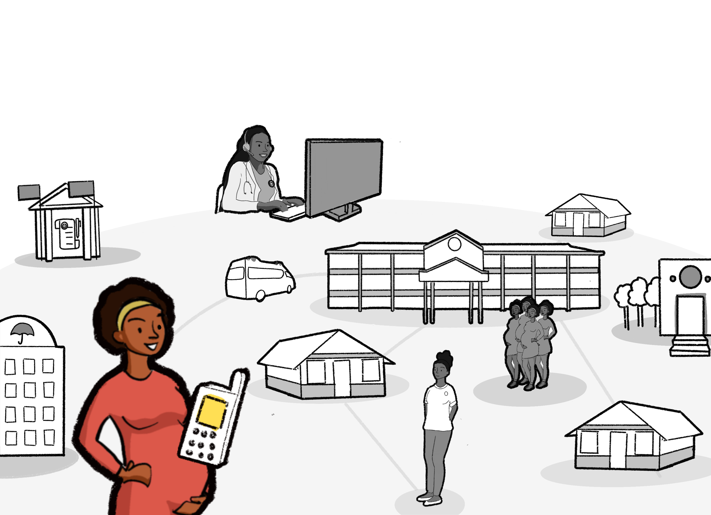
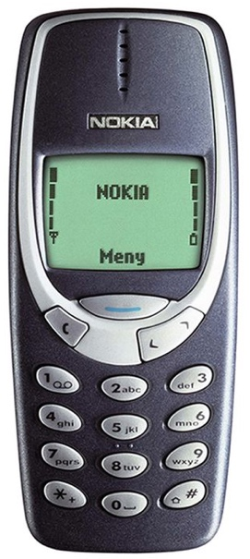
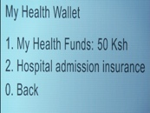
Any mother with a mobile phone can participate in MomCare
Mobile wallet
Visit reminders
SMS surveys
End of journey calls

Slide 15
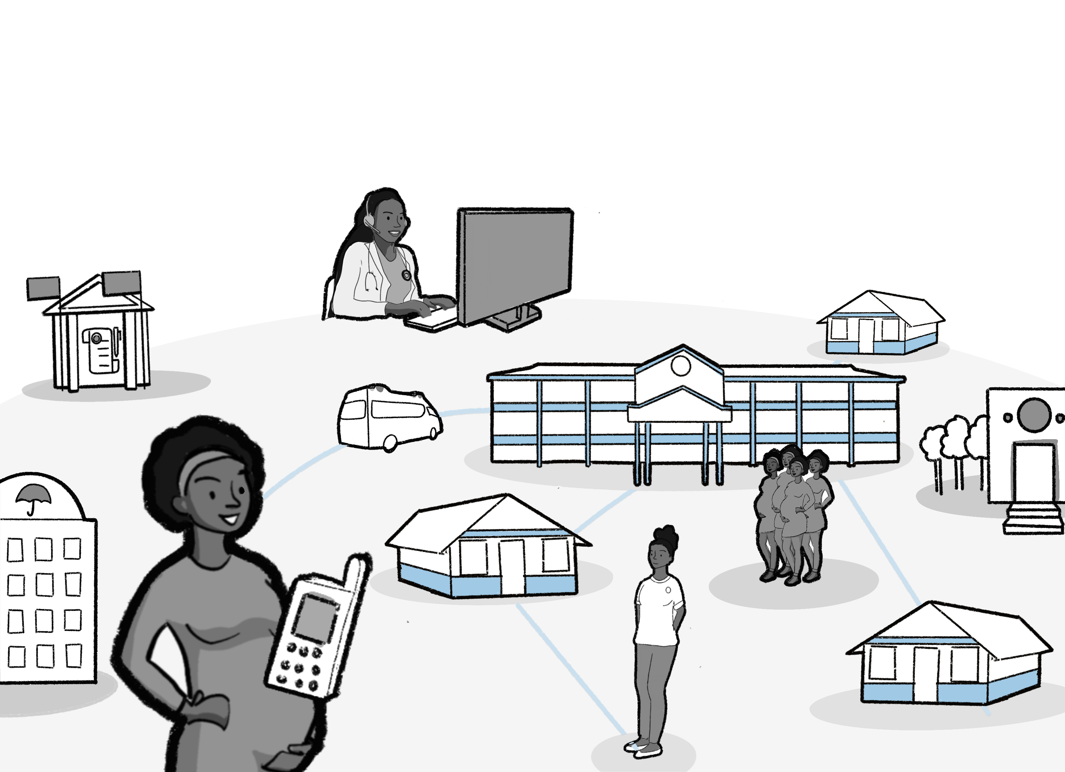
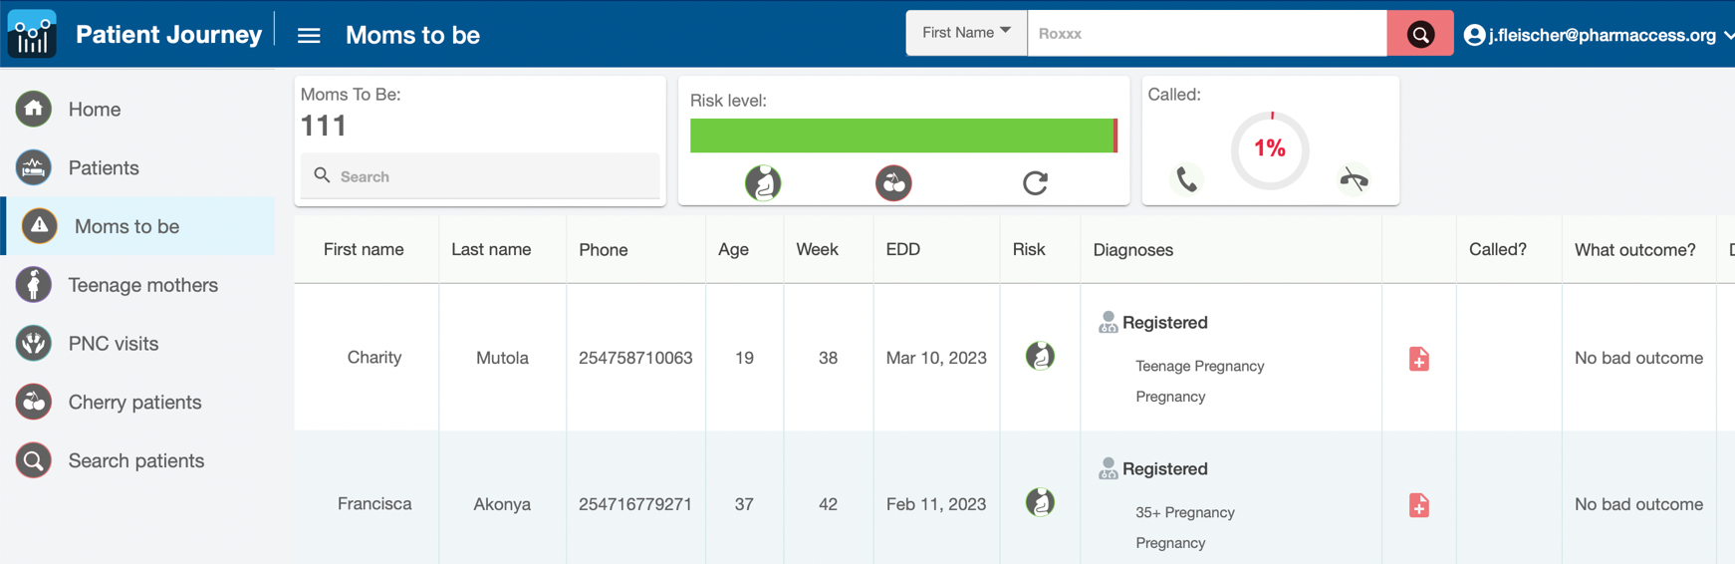
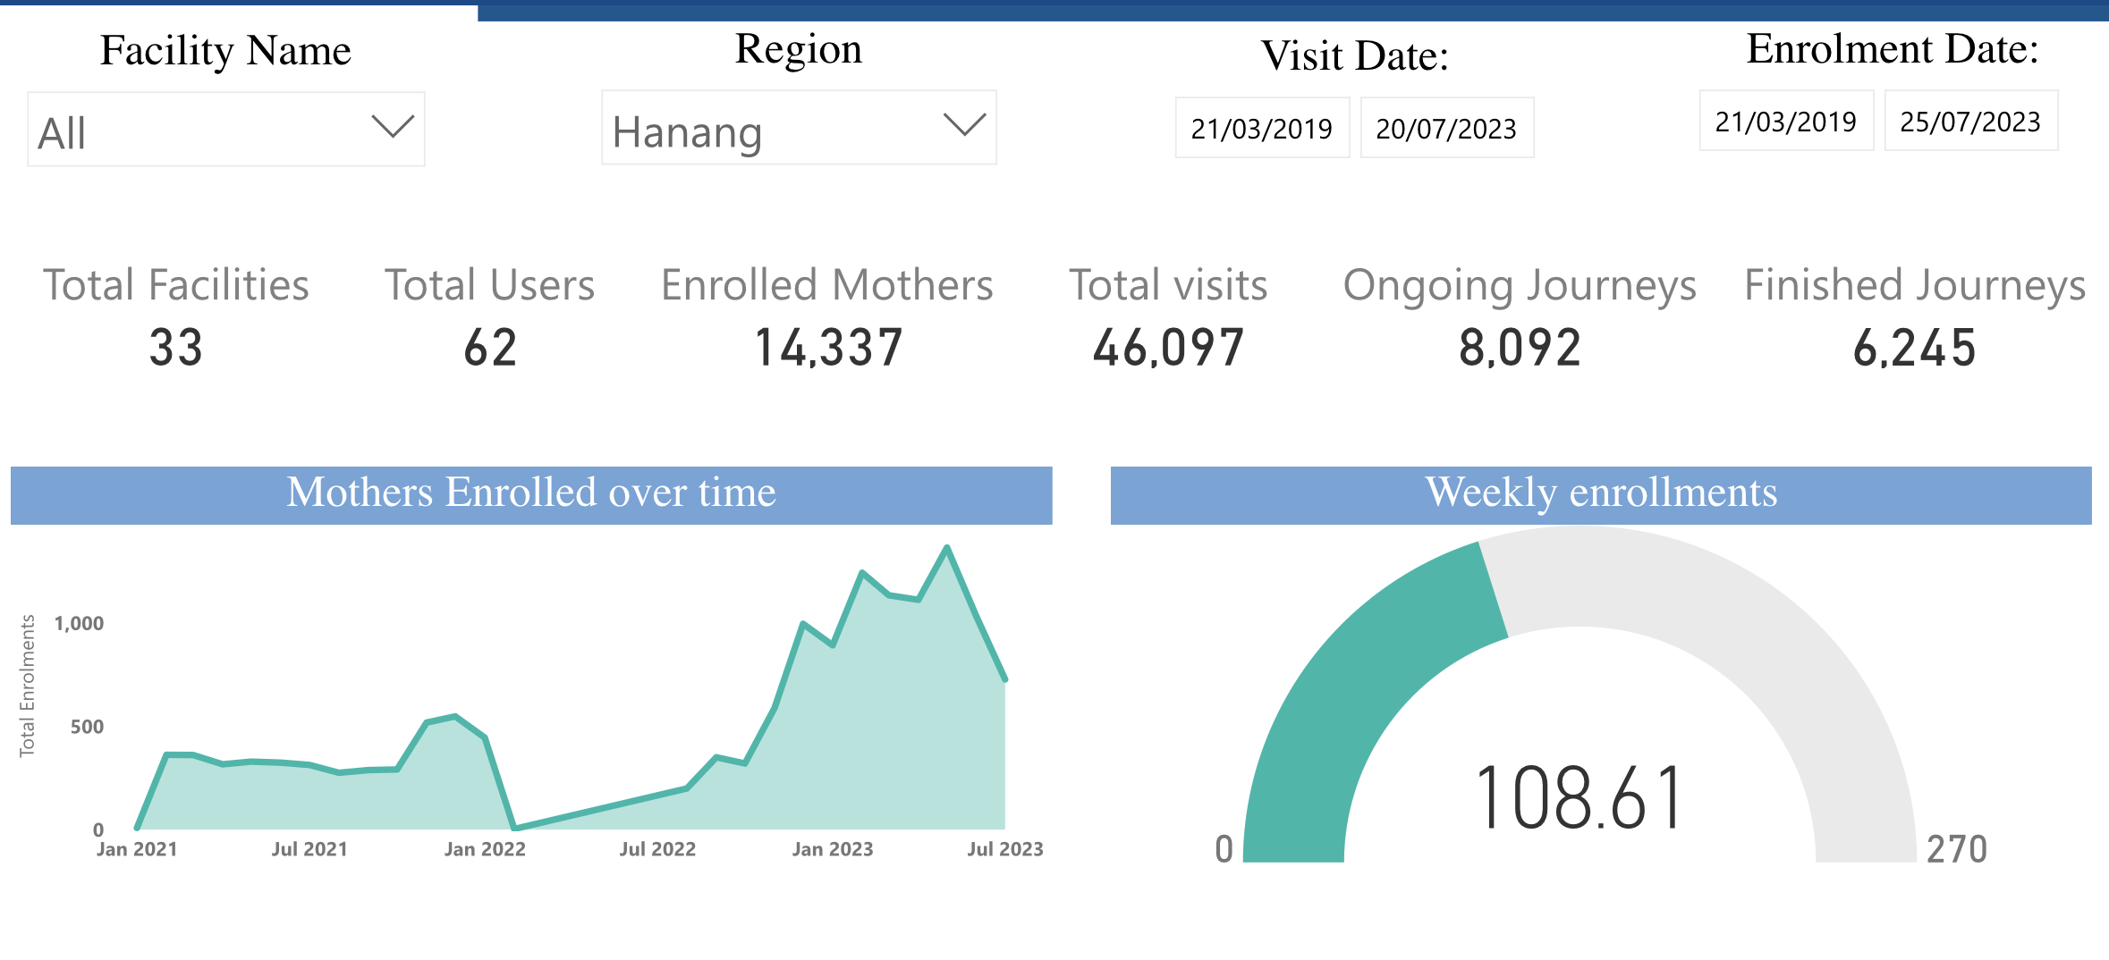
Providers get daily operational support and VBC insights
Operational support
Risk stratification
Test & Treat flagged cases
Pre-delivery filter lists
Moms2Be calls
Referrals
VBC insights
VBC payments

Slide 16
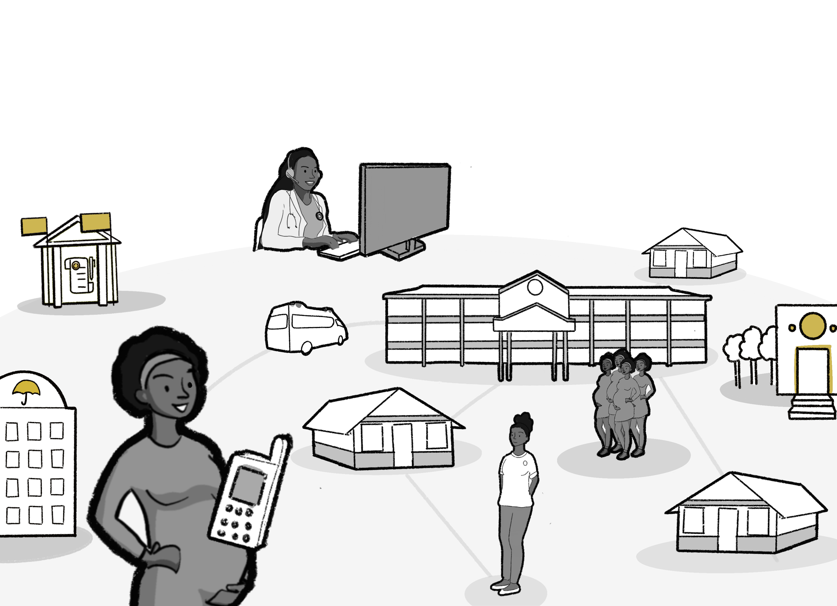
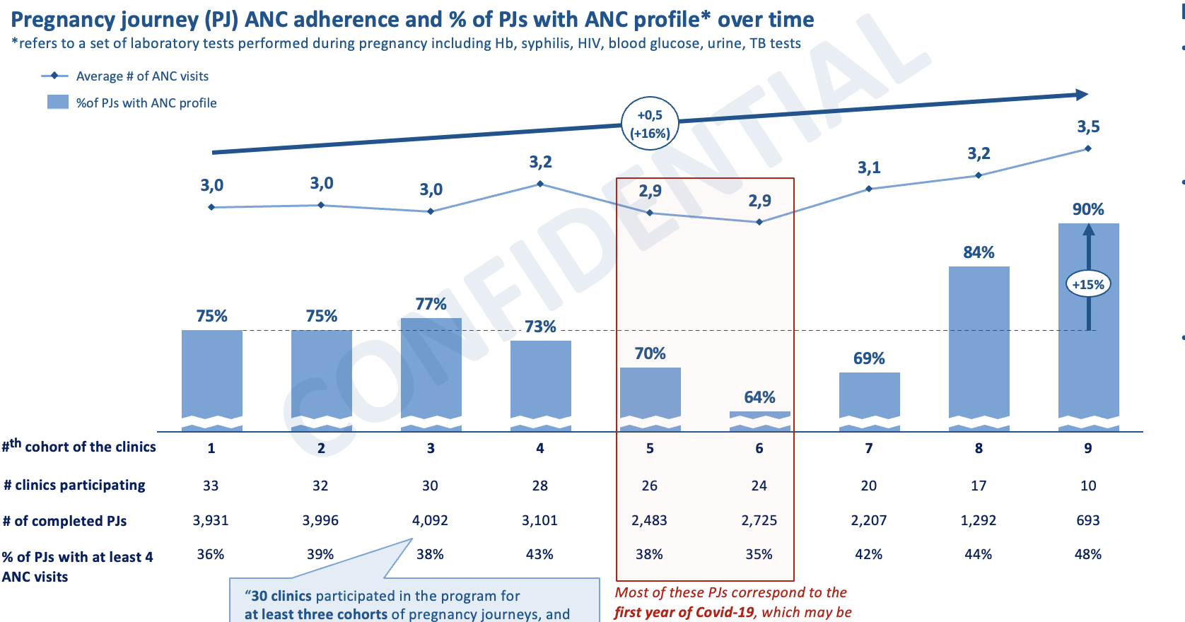
Detailed analyses are available to additional stakeholders
Detailed analyses for
Payers
Policy makers
Researchers

Slide 17
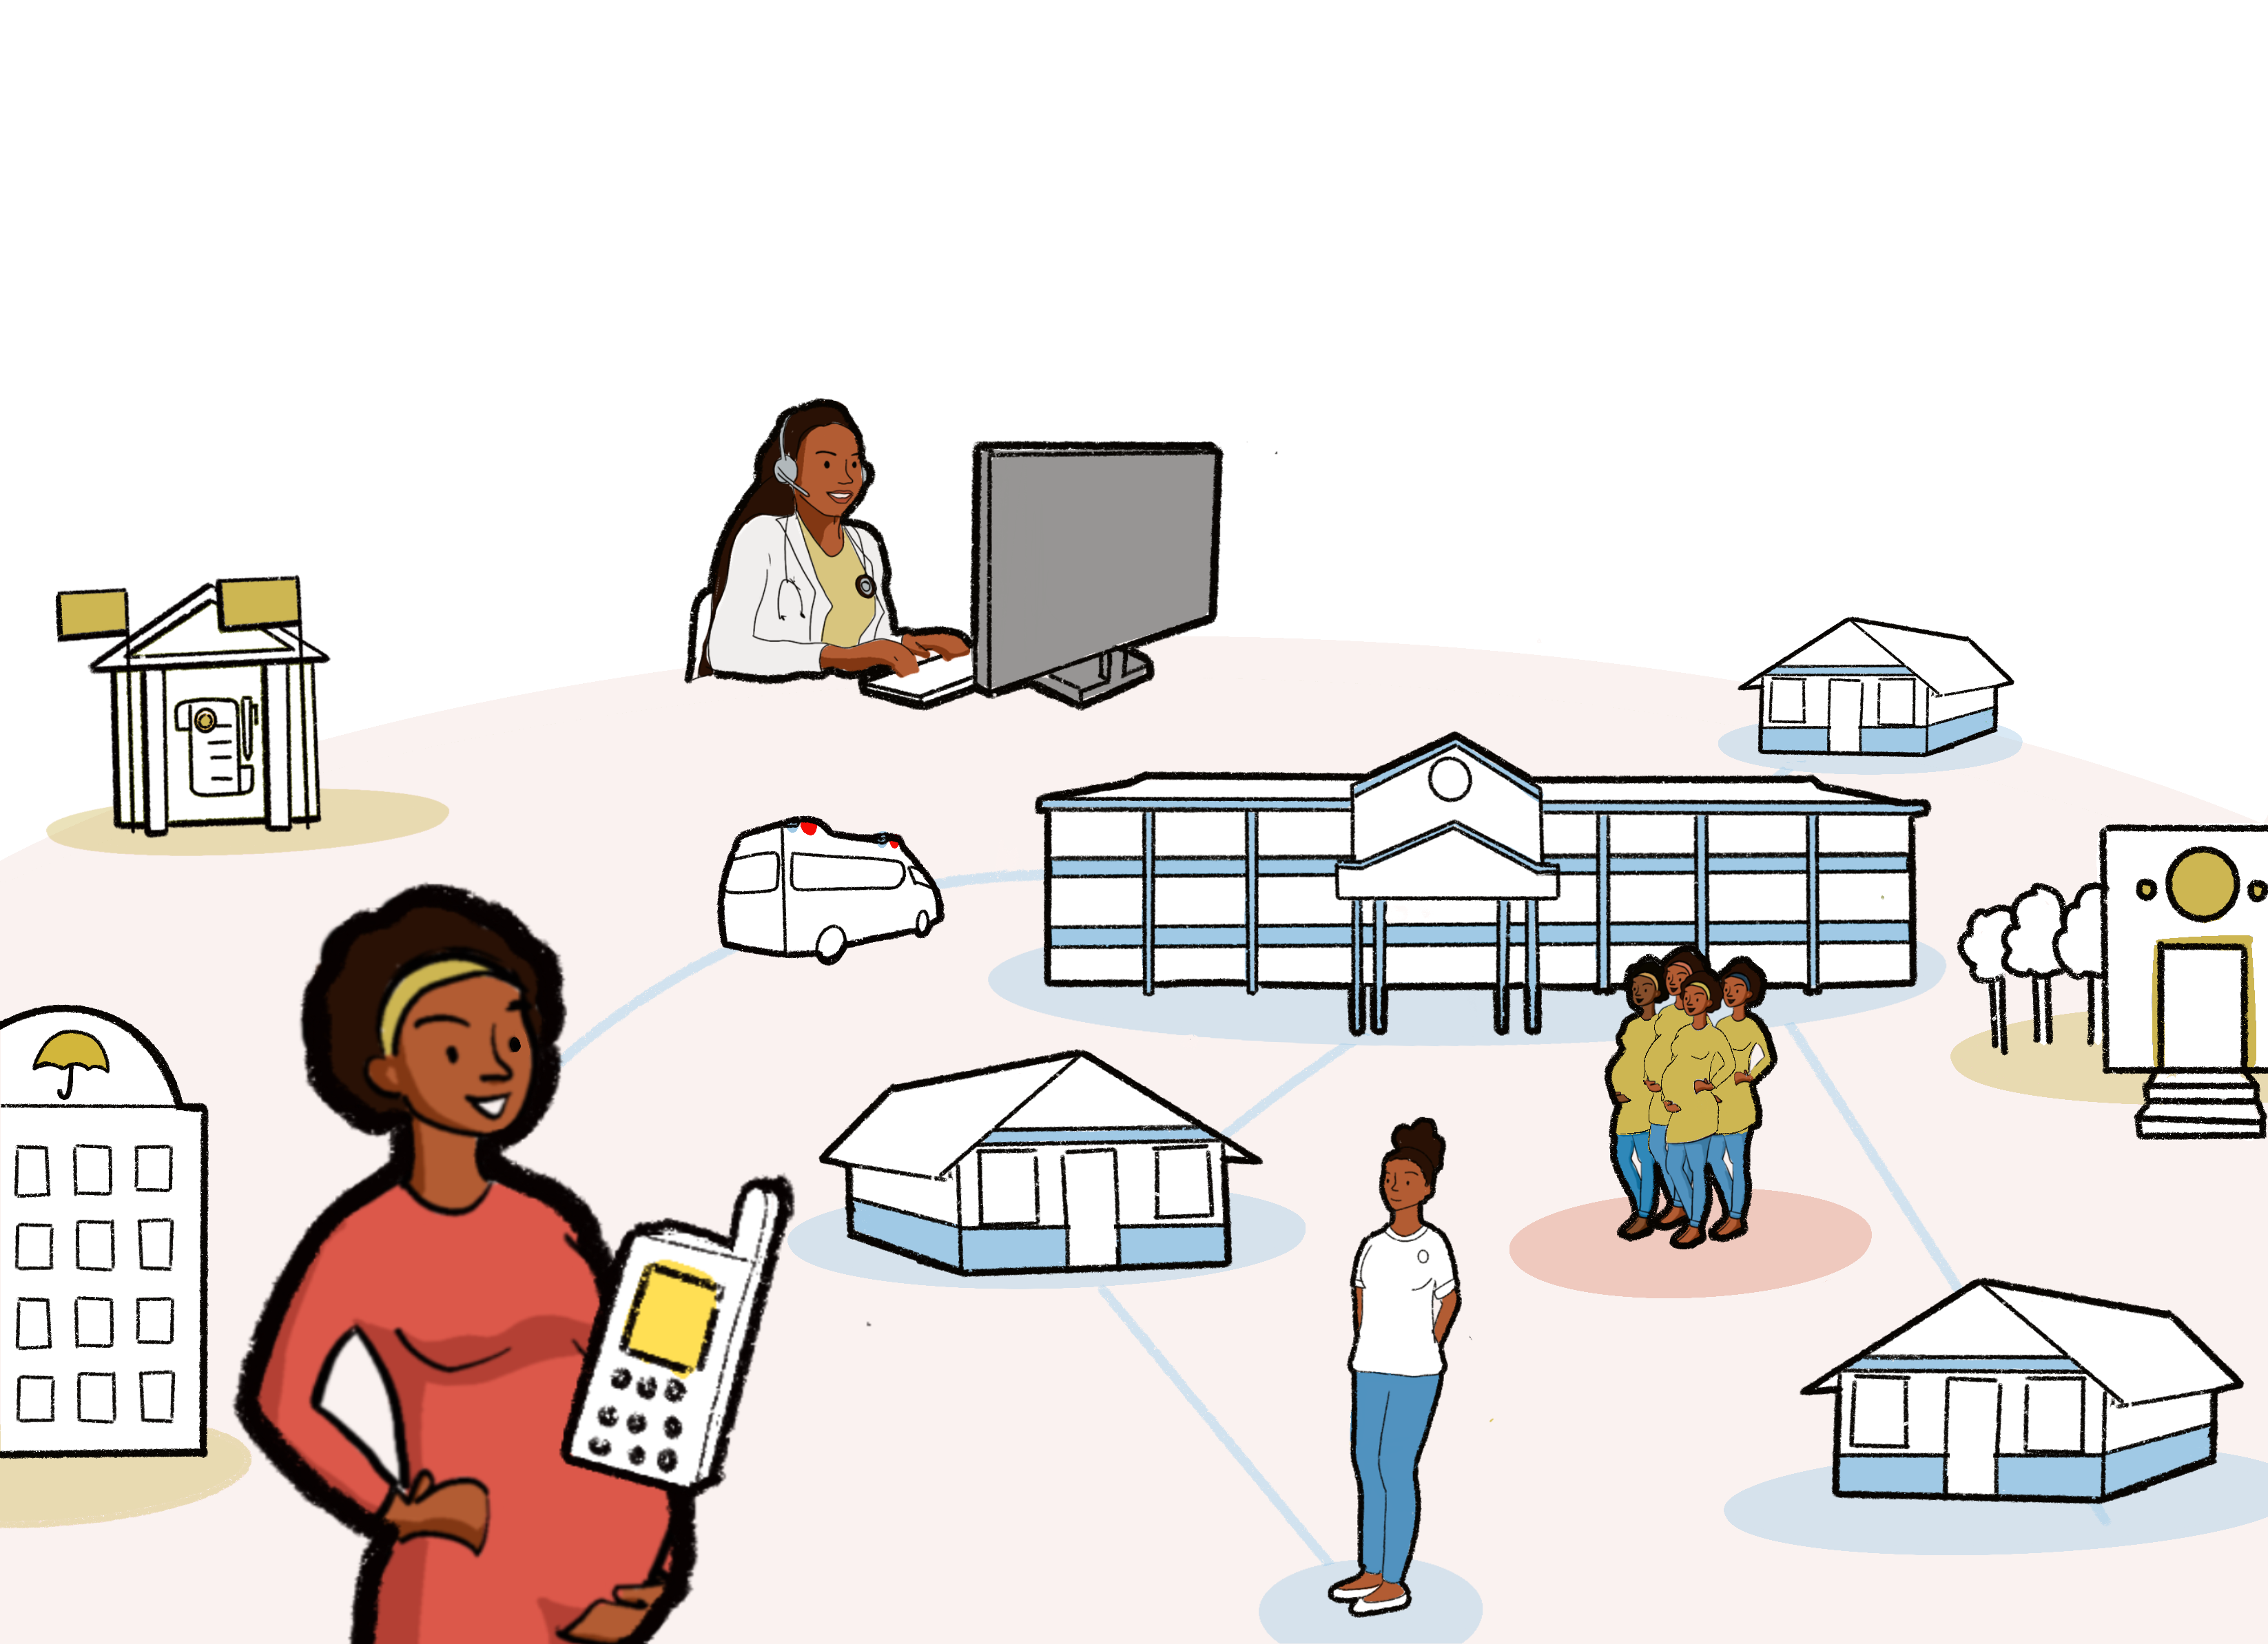
MomCare is ready for the next step
Ecosystem changes
Digitization
Standardization
Telehealth
Adoption
Enable shifting focus
Scaling through interoperability

Slide 18
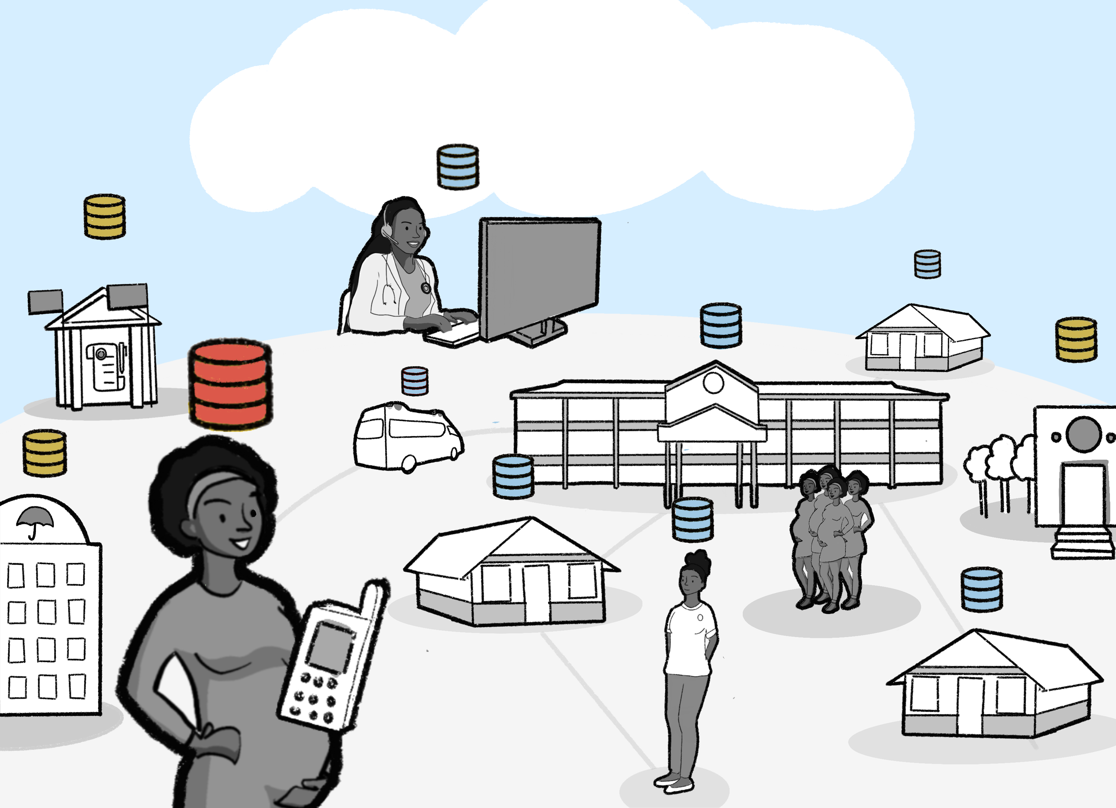
Interoperable data-exchange will enable value-based maternity care that is platform-agnostic
Practically this means
Plug & play
Expansion of services
Innovation of
Care delivery models
Business models

Slide 19
Primary vs secondary reuse
Primary data reuse
Positioned within routine health delivery process, envisioned to be a market of supplier of business services
Secondary data reuse
Positioned as reuse of data for policy, analytical and intelligence purposes by government, academic institutions, pharma companies etc.

Slide 20
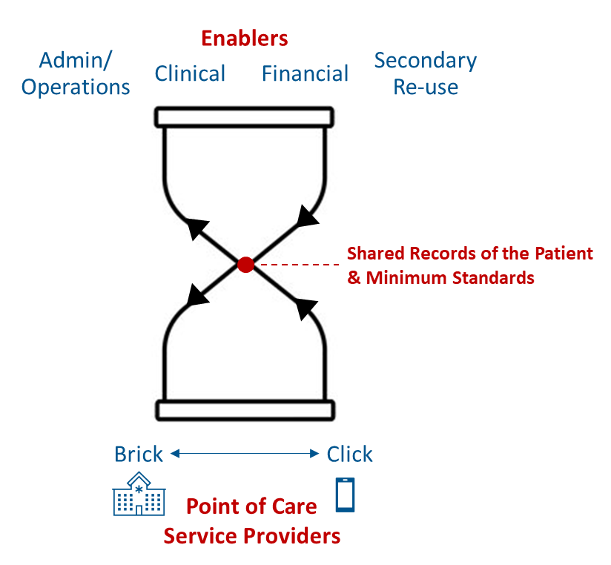





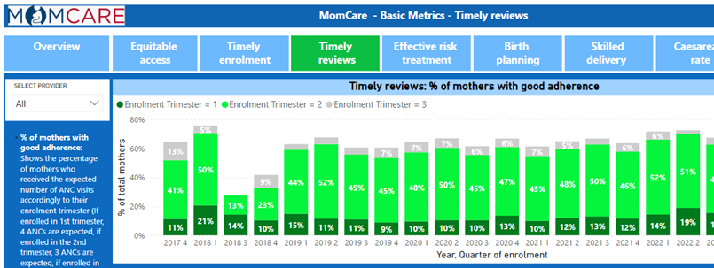
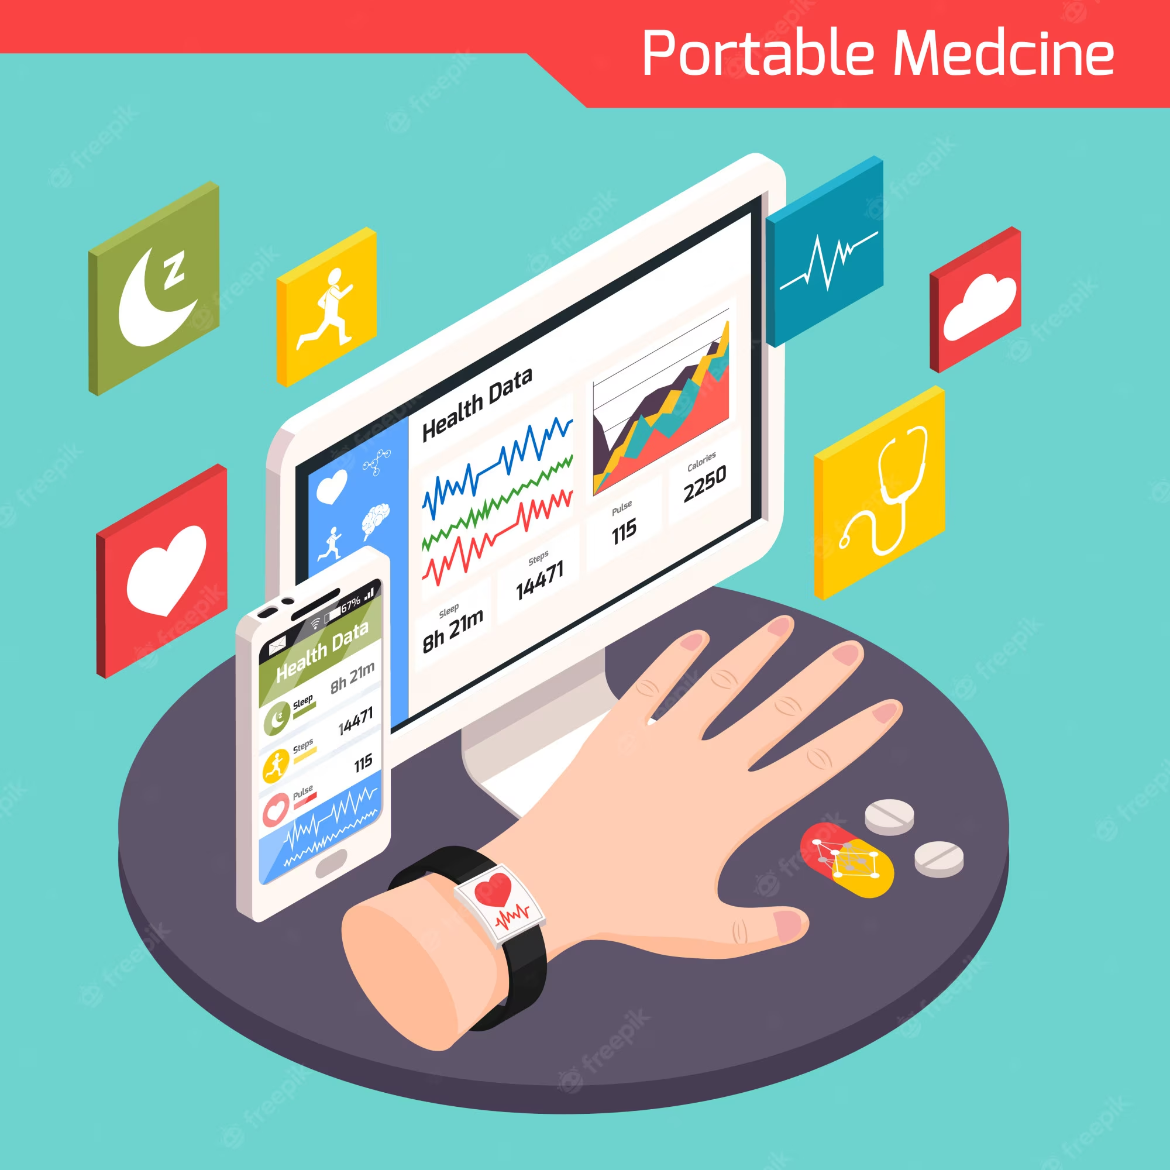



Examples of reuse
PharmAccess
enabling the clinics with Cash Advance
PharmAccess
informing donors/investors on the quality of healthcare providers
Insurance companies
aggregating demand and facilitating access to healthcare services
Journey analytics
informing all stakeholders on the services provided and outcomes
Portable health data
organizing supply to improve care delivery
Management use cases
informing clinic management to improve operations
Re-use of data for research and analytics
connecting third parties to create value based on available data

Slide 21
Develop new care concepts with ‘BRICK’ and ‘CLICK’ service providers
‘BRICK’
Service Providers
Healthcare facilities with traditional care delivery models
CHWs
Primary healthcare facilities
Secondary/Referral healthcare facilities
PharmAccess
Patient Groups
organizing demand for healthcare and care delivery by bringing together traditional and digital models
‘CLICK’
Service Providers
Innovative providers with digital care delivery/organization models
Fintech
Remote care / Self-management platforms
Care planning/management platforms

Slide 22
We develop ecosystems focusing on patient needs, advocating for personal data rights, and breaking vendor lock-ins
We develop open-source code to create shared records and data translators to support:
Data Security and Privacy
Data Integrity (with validation and correction methods)
Data Governance
Data Integration and Exchange
Interoperability Solutions
Data Visualization and Reporting Solutions
Technical Stakeholders
Regulatory Compliance
Data Consent Management
Legal Stakeholders
Electronic Health Records
Patient Data Sharing (across platforms)
Healthcare Analytics
Common Services

Slide 23






WHAT: Results technical demonstrators with MomCare Tanzania
PoS: Chain of Trust app functions as electronic medical record for MomCare programme
Interoperability: Demonstrator for FHIR translation to create ‘data station’ of shared health record for re-use
Business Services:
Automation of DHIS2 reporting based on shared health records
Implementation of Value Points Dashboard based on shared health records
Capability for plug-&-play publishing of dashboards into existing mobile web that is resilient to intermittent Internet connections
Analytics Services:
Configured analytics workbench (in-the-clear)
Pilot multi-party computation (MPC, in-the-blind)
COMMON
SERVICES
CR - Client Registry
FR - Facility Registry
HWR - Health Worker Registry
TS - Terminology Services
PC - Product Catalogue
BUSINESS
SERVICES
FIS - Finance & Insurance Service
HMIS - Health Mgt. Info. System
LMIS - Logistics Mgt. Info. Service
SHR - Shared Health Record
DS - Data Services (?!)
ANALYTICS & INTELLIGENCE SERVICES
Secondary re-sue of data
DHIS2 report
Shared Health Record
Value Points Dashboard
Analytics workbench
INTEROPERABILITY LAYER (IOL)
AC - Admin Console
ATNA - Audit Trail & Node Authentication
ILS - Interlinking and Routing Services, also known as Channels in the reference implementation
MEDIATORS - Pass-through, Adapter or Orchestration mediators
FHIR legacy mediator
POINT OF SERVICE (POS) SYSTEMS
Different types of PoS systems are allowed, including EMR/EHRs (Electronic Health / Medical Record systems), mobile apps for patient or community workers and information systems for hospitals, pharmacies and laboratories.
Key defining characteristics are the workflows that are supported by the system (see examples).
Chain of Trust app

Slide 24
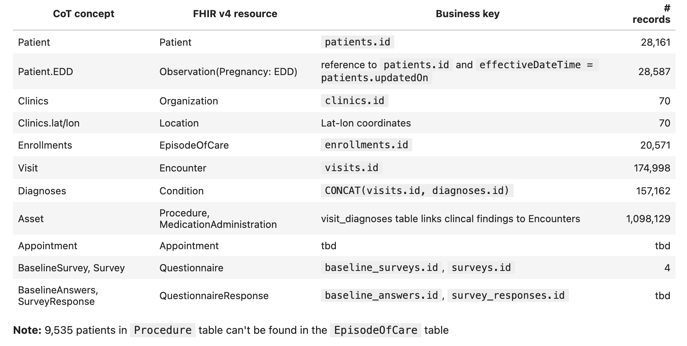
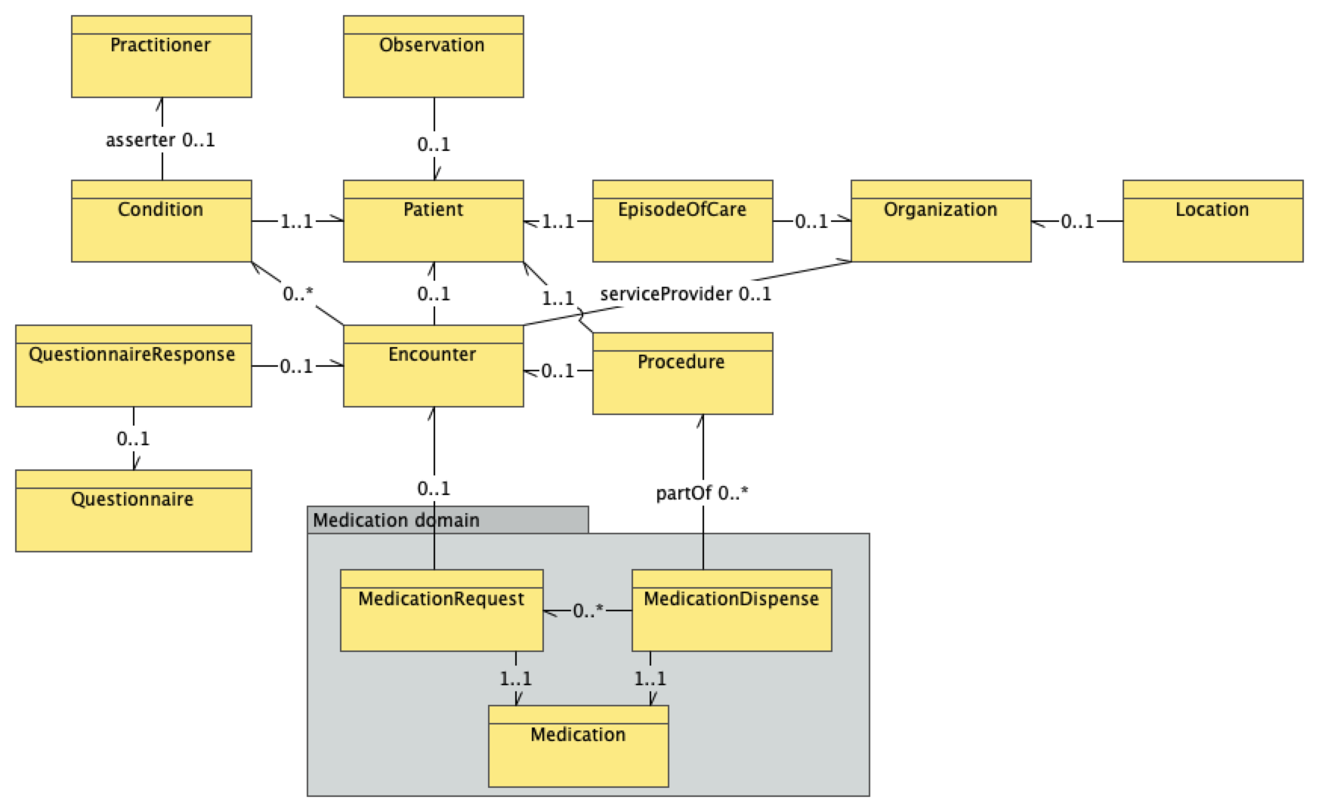
Lessons learned: standardizing data into FHIR IPS without loss of information
International Patient Summary data model

Slide 25
Lessons learned: SQL-on-FHIR approach to standardize analytics
As more data becomes available in the FHIR® standard, we need to make that data to work well with in widely-used data analysis tools
Challenge: the nested structure of FHIR resources makes it difficult to use in analytic databases and tools built on top of them
Solution: From resources to flattened views to information products
Analytics and reports, e.g. DHIS2 and VBHC metrics
Analytics layer
View layer
Standardized, tabular view, e.g. patient timeline
Data layer
Original, nested FHIR data
For more details see SQL-on-FHIR v2 Implementation Guide (work in progress)

Slide 26
For discussion: ‘Health Data Commons’ and potential ecosystem partners
Aim to achieve interoperability with existing programmes such as DHIS2, openIMIS
Partners such as Infospective can help demonstrate new care models
Opportunities for collaboration with insurance companies
Independent organization, for example universities, can act as custodian for governing secondary data re-use
Pharma industry, e.g. IQVIA, seeking real-world evidence
Possible funders for kick-starting data commons?
COMMON
SERVICES
BUSINESS
SERVICES
ANALYTICS & INTELLIGENCE SERVICES
Local authorities are key stakeholder, our aim is to help and accelerate implementation of interoperability layer and common services
INTEROPERABILITY LAYER (IOL)
POINT OF SERVICE (POS) SYSTEMS
Suppliers of PoS systems at community level, for example, Medtronic Spice, remote diagnostics
Suppliers of PoS systems at facility level, for example, AfyaRecod, Elephant, bahmni
Suppliers of PoS systems for pharmacies
Suppliers of PoS systems for laboaratories

Slide 27

Thank you.

